Slide 1

Predicting the Likelihood of Client Default on Loans
Bronchos Financial Services

Slide 2
Agenda
Introduction and Objective
Data Understanding
Exploratory Analysis
Modeling and Evaluation
Conclusion
Question and Answers

Slide 3
Introduction
Bronchos Financial Services located in Edmond, Oklahoma offers a home equity line of credit to its customers.
The company has extended several thousand lines of credit in the past, and many of these accepted applicants have defaulted on their loans.

Slide 4

Objective
Reduce the default rate by identifying the clients who are most likely to default their loans

Slide 5

Data Understanding
The dataset contains geographic, demographic and financial variables.
The dataset has 2882 records and 12 variables.

Slide 6
Data Description
Variable Name | Model role | Measurement Level | Description
AD | Target | Binary | A value of 1 indicates that the client defaulted on the loan or is seriously delinquent. A value of 0 indicates that the client paid off the loan.
CLAGE | Input | Interval | Age of the oldest credit line, measured in months
CLNO | Input | Interval | Number of credit lines
DEBTINC | Input | Interval | Debt-to-income ratio
DELINQ | Input | Interval | Number of delinquent credit lines
DEROG | Input | Interval | Number of major derogatory reports
JOB | Input | Nominal | Occupational categories
LOAN | Input | Interval | Amount requested for the loan
MORTDUE | Input | Interval | Amount due on the existing mortgage
NINQ | Input | Interval | Number of recent credit inquiries
REASON | Input | Binary | The value DebtCon indicates that the loan was intended for debt consolidation. The value HomeImp indicates that the loan was for home improvement.
VALUE | Input | Interval | Value of the current property
YOJ | Input | Interval | Years at the applicant’s current job

Slide 7
Exploratory Analysis
Fit statistics of data (Neural Network - Validation)
Average Squared Error | 0.096777
Maximum Absolute Error | 0.987456
Divisor for ASE | 2884
Sum of Frequencies | 1442
Root Average Squared Error | 0.31109
Sum of Squared Errors | 279.1055
Sum of Case Weights Times Frequency | 2884
Mean Squared Error | 0.096777
Root Mean Squared Error | 0.31109
Average Error Function | 0.334719
Error Function | 965.3294
Number of Wrong Classifications | 172

Slide 8
Exploratory Analysis
Summary statistics of interval variables
Variable | Mean | Standard Deviation | Missing | Minimum | Median | Maximum | Skewness | Kurtosis
CLAGE | 169.9144 | 76.63339 | 202 | 0 | 163.0891 | 475.8 | 0.56669 | 0.025768
CLNO | 20.17524 | 10.14796 | 160 | 0 | 19 | 71 | 0.798614 | 1.145844
DEBTINC | 32.91804 | 7.76092 | 762 | 0.524499 | 34.17406 | 91.6126 | -0.12408 | 3.608942
DELINQ | 0.492112 | 1.113219 | 283 | 0 | 0 | 15 | 3.615973 | 21.16389
DEROG | 0.263179 | 0.87801 | 378 | 0 | 0 | 9 | 5.126283 | 33.22541
LOAN | 10655.73 | 3401.711 | 0 | 110 | 11000 | 16000 | -0.37668 | -0.70519
MORTDUE | 64156.89 | 31387.44 | 282 | 2063 | 60301 | 399550 | 1.368087 | 6.734174
NINQ | 1.140937 | 1.747099 | 278 | 0 | 1 | 17 | 2.941516 | 12.38522
VALUE | 83951.14 | 37421.37 | 61 | 8800 | 78000 | 268000 | 1.399177 | 3.089137
YOJ | 8.317153 | 7.229425 | 209 | 0 | 6 | 41 | 1.043112 | 0.501803

Slide 9
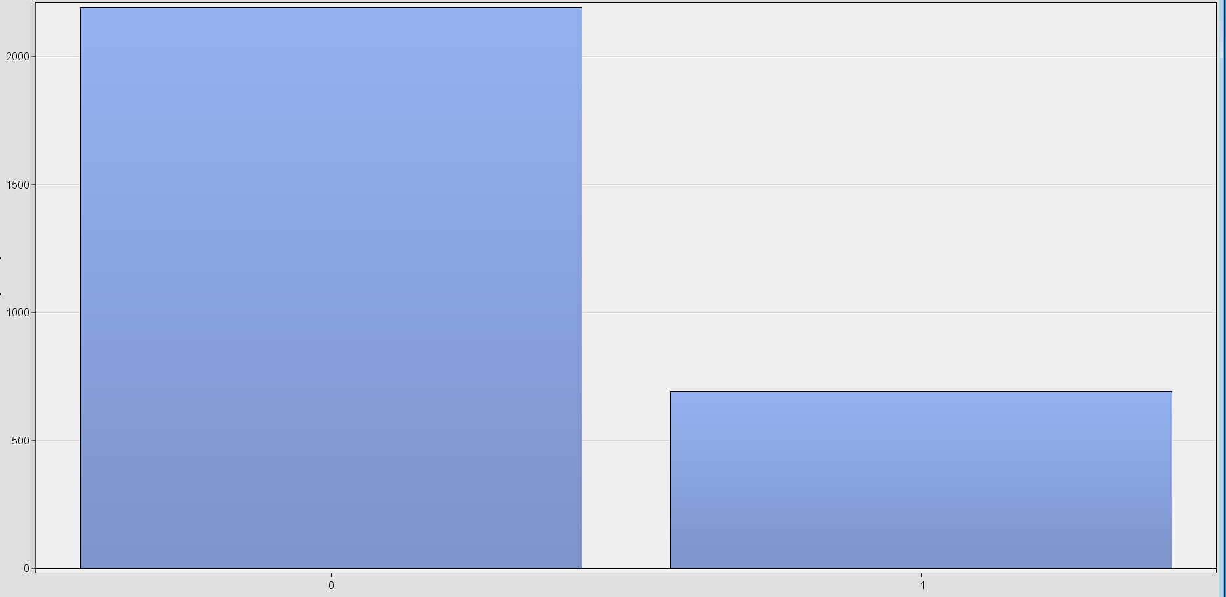
Exploratory Analysis
Number of clients that defaulted and number of clients who paid off the loan

Slide 10
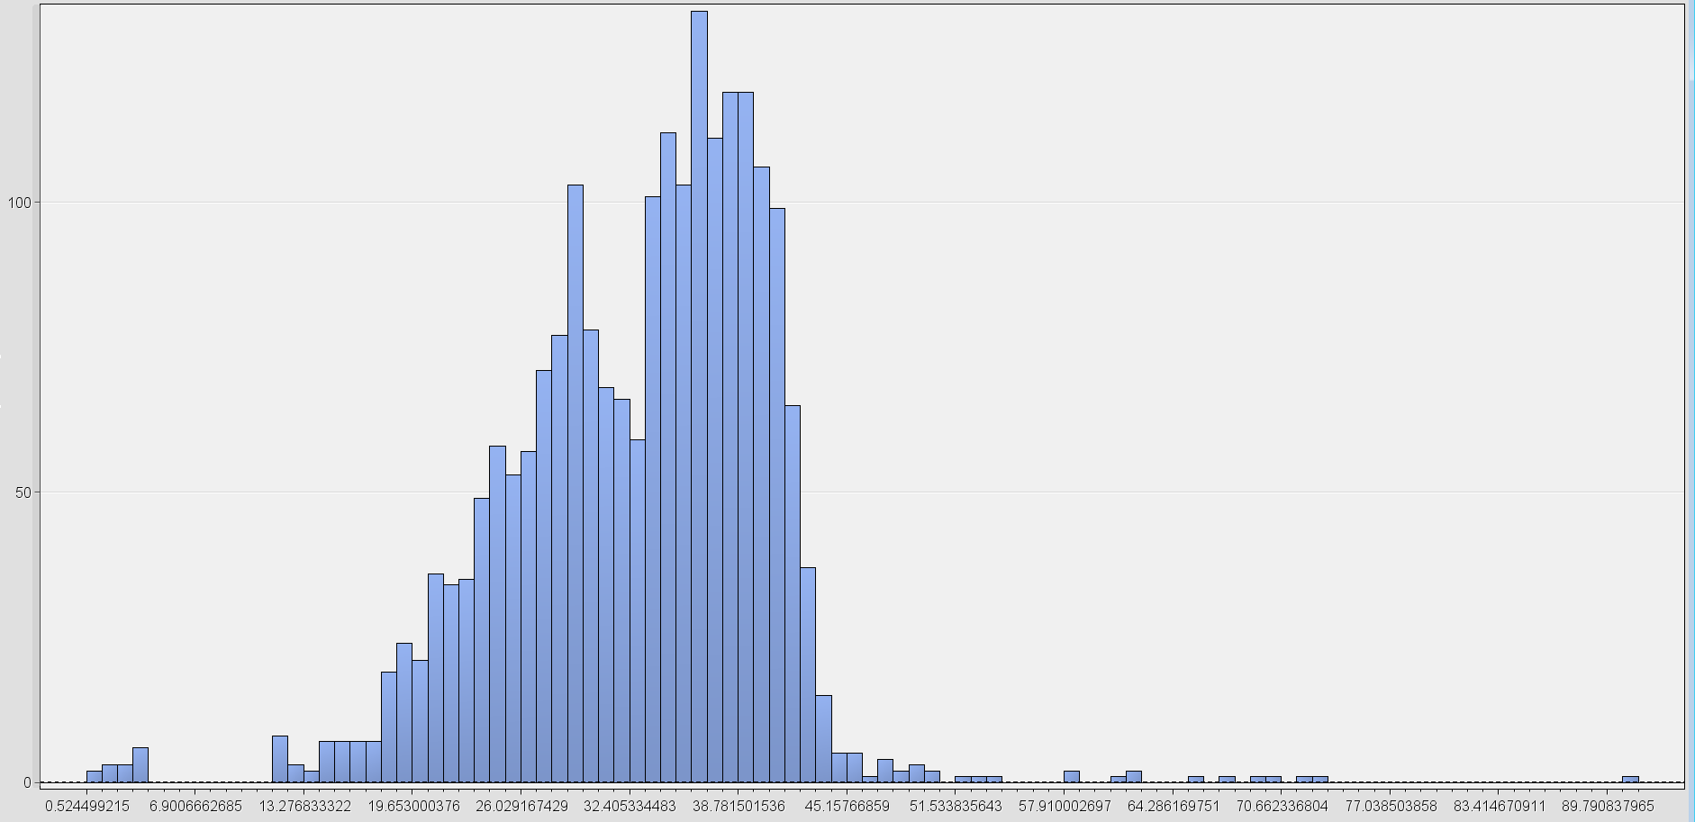
Exploratory Analysis
Debt-to-income ratio

Slide 11
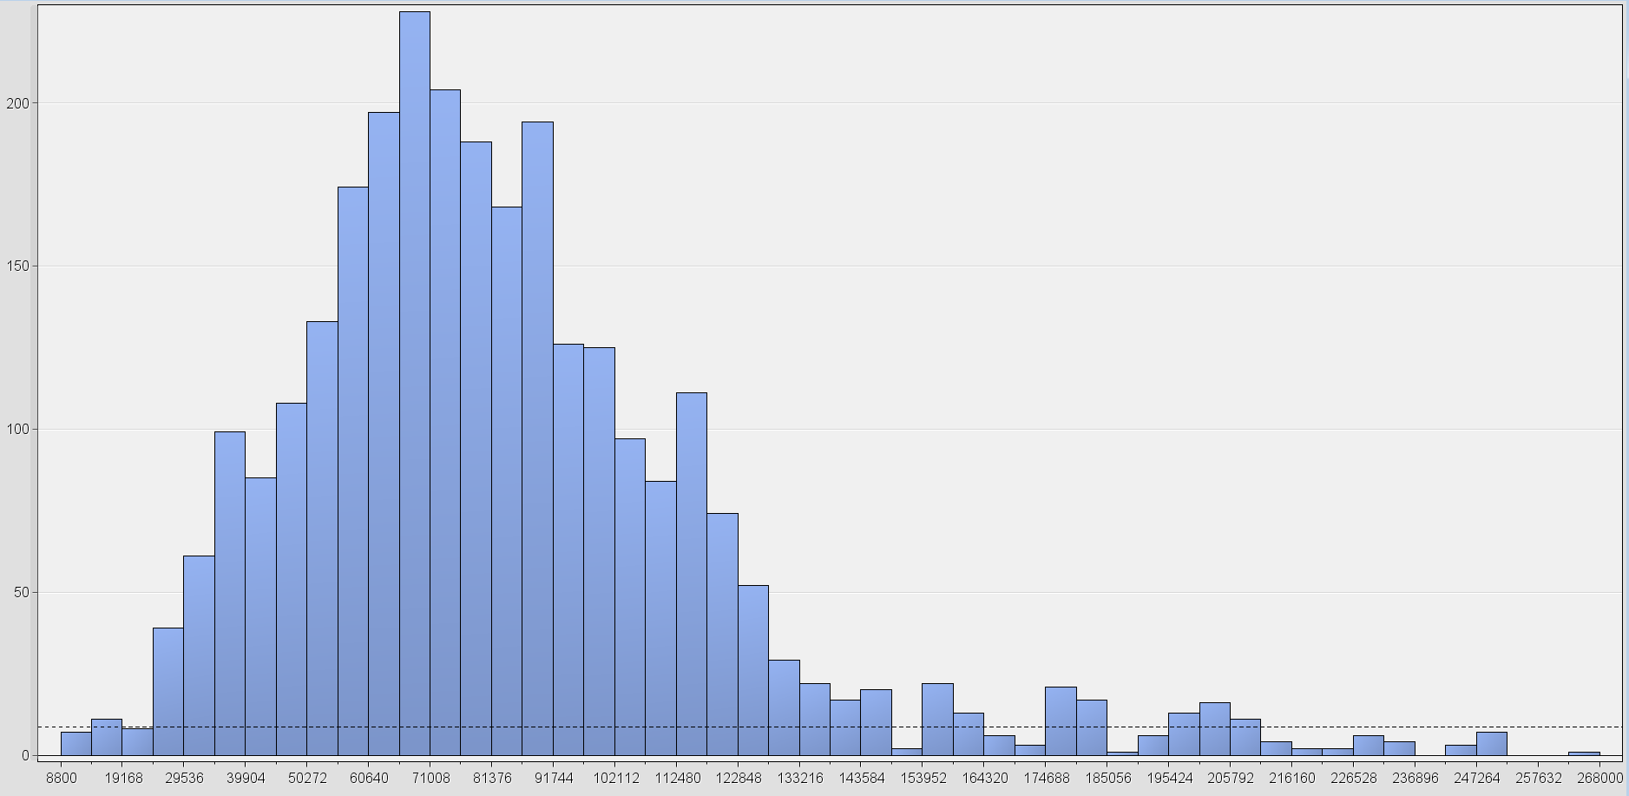
Exploratory Analysis
Value of current property

Slide 12
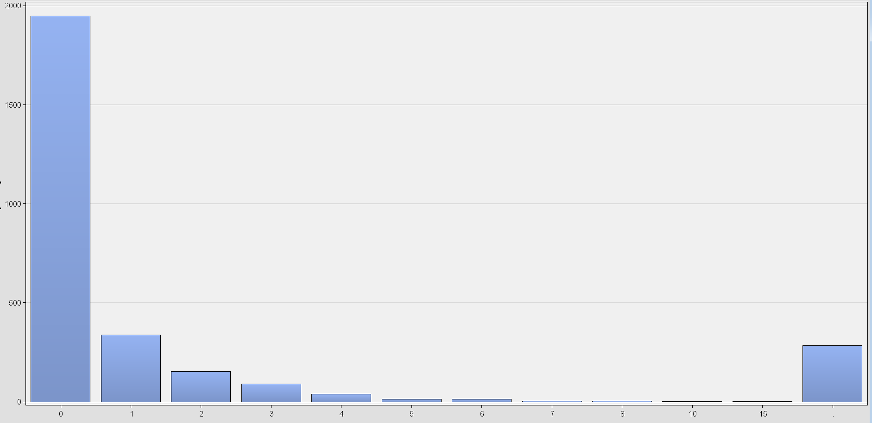
Exploratory Analysis
Number of delinquent credit lines

Slide 13
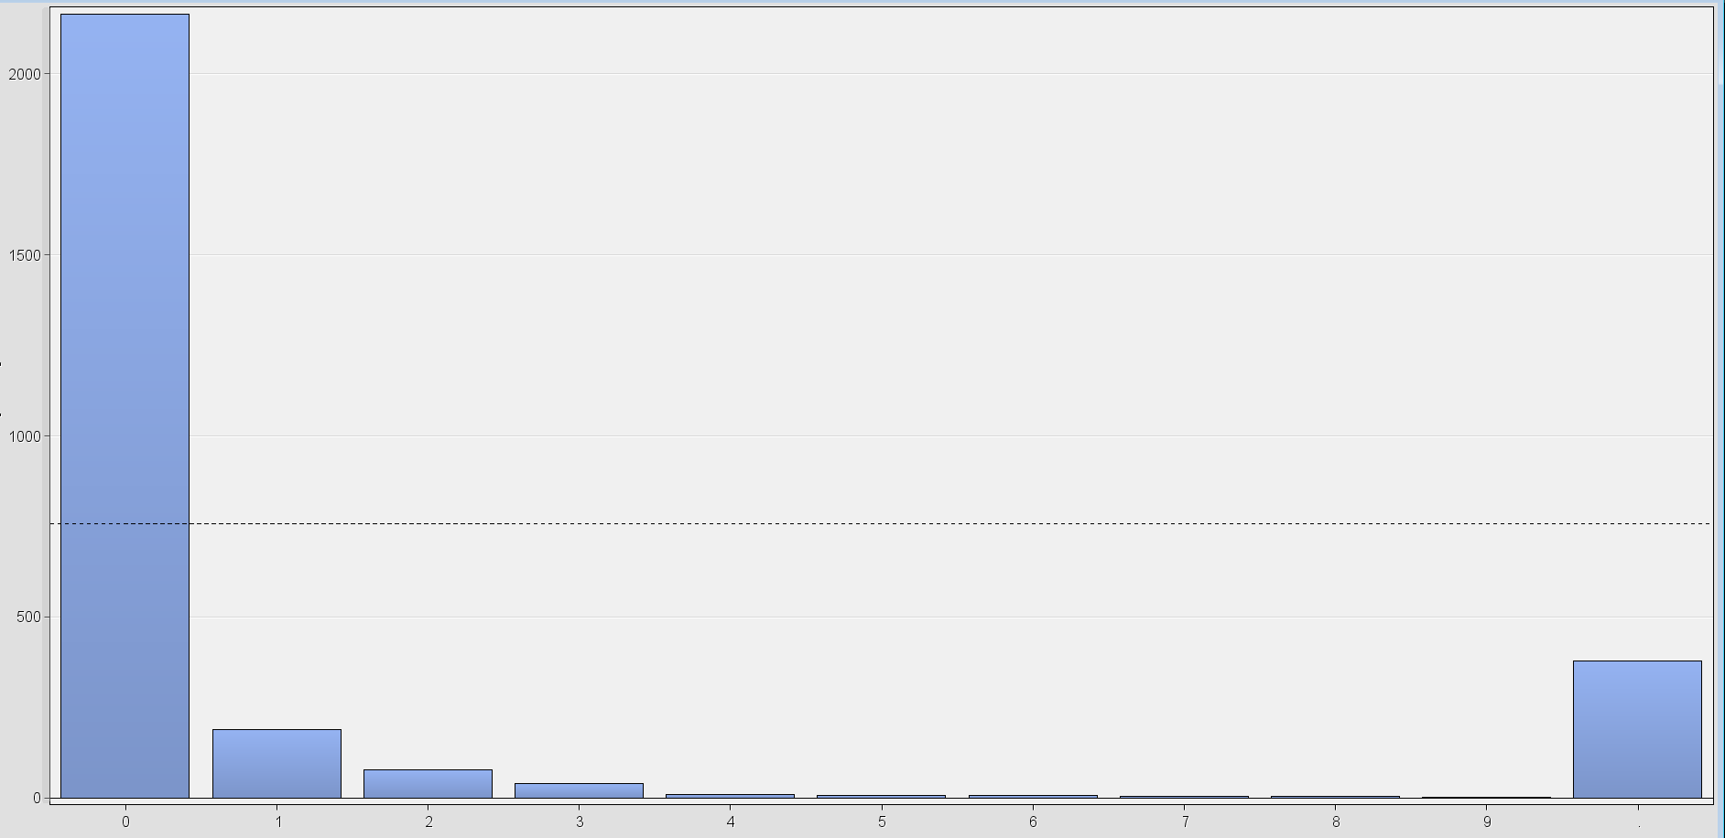
Exploratory Analysis
Number of major derogatory reports

Slide 14
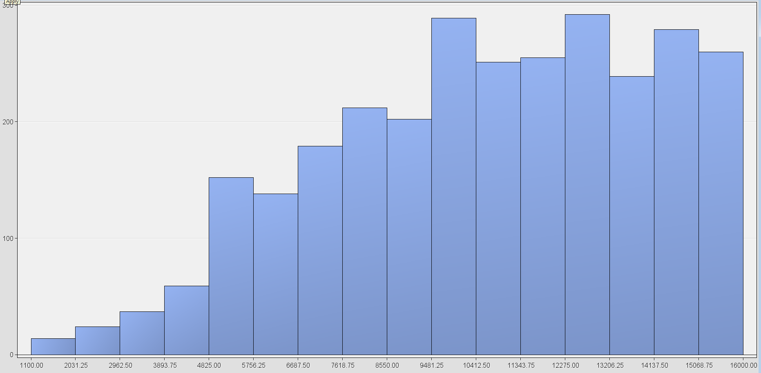
Exploratory Analysis
Amount requested for the loan

Slide 15
Transformation
Original Computed
Variable Name | Skewness
CLAGE | 0.519428
CLNO | 0.799244
DEBTINC | -0.12988
DELINQ | 4.140599
DEROG | 5.142324
LOAN | -0.42143
MORTDUE | 1.602769
NINQ | 2.885676
VALUE | 1.363252
YOJ | 1.036355
Variable Name | Skewness
LOG_CLAGE | -2.2331
LOG_CLNO | -1.67025
LOG_DEBTINC | -3.72361
LOG_DELINQ | 1.946589
LOG_DEROG | 2.972934
LOG_LOAN | -1.51347
LOG_MORTDUE | -1.3718
LOG_NINQ | 0.841178
LOG_VALUE | -0.2801
LOG_YOJ | -0.47915

Slide 16
Imputation
Variable Name | Imputed Method | Imputed Variable | Impute Value | Number of Missing Values
JOB | COUNT | IMP_JOB | Other | 97.0
LOG_CLAGE | MEAN | IMP_LOG_CLAGE | 5.0091213898 | 114.0
LOG_CLNO | MEAN | IMP_LOG_CLNO | 2.9057956813 | 90.0
LOG_DEBTINC | MEAN | IMP_LOG_DEBTINC | 3.4800494808 | 366.0
LOG_DELINQ | MEAN | IMP_LOG_DELINQ | 0.2383583746 | 142.0
LOG_DEROG | MEAN | IMP_LOG_DEROG | 0.1233109605 | 177.0
LOG_MORTDUE | MEAN | IMP_LOG_MORTDUE | 10.920514857 | 141.0
LOG_NINQ | MEAN | IMP_LOG_NINQ | 0.5284674249 | 143.0
LOG_VALUE | MEAN | IMP_LOG_VALUE | 11.253334843 | 33.0
LOG_YOJ | MEAN | IMP_LOG_YOJ | 1.8651081186 | 109.0
REASON | COUNT | IMP_REASON | DebtCon | 70.0

Slide 17
Modeling
Misclassification Tree
Selection Tree: Neural Network
Stepwise Regression
Neural Network
Partial Least Squares: Neural Network
Variable Selection: Neural Network

Slide 18
Stepwise Regression
Final variables in the model
IMP_LOG_CLAGE IMP_LOG_DEBTINC IMP_LOG_DELINQ IMP_LOG_DEROG IMP_LOG_VALUE M_JOB M_LOG_DEBTINC M_LOG_VALUE
Odds Ratio
IMP_LOG_CLAGE 0.434
For each additional month in credit line, the odds of the client defaulting on a loan change
by a factor of 0.434, a 56.6% decrease.
IMP_LOG_VALUE 0.437
For each additional dollars in value of current property, the odds of the client defaulting on a loan change by a factor of 0.437, a 56.3% decrease.
M_JOB 0 vs 1 6.568
For cases with a 0 value for M_JOB, the odds of the client defaulting on a loan are 6.568 times higher than the odds of defaulting for cases with a 1 value for M_JOB

Slide 19
Selecting the Champion Model
Model | Misclassification Rate | ROC Index
Neural Network | 0.119279 | 0.92
Selection Tree: Neural Network | 0.124133 | 0.926
Variable Selection: Neural Network | 0.124827 | 0.903
Stepwise Regression | 0.136616 | 0.91
Misclassification Tree | 0.147018 | 0.838
Partial Least Squares: Neural Network | 0.154646 | 0.856

Slide 20
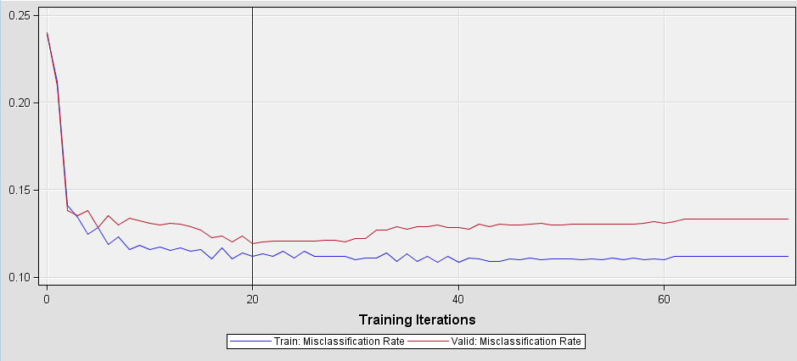
Results from the Champion Model
Misclassification Rate | ROC Index
0.119279 | 0.92

Slide 21
Conclusion
The most important variables for predicting the likelihood of a client defaulting on a loan are:
Age of the oldest credit line (CLAGE)
Debt-to-income ratio (DEBTINC)
Number of delinquent credit lines (DELINQ)
Number of major derogatory reports (DEROG)
Occupational categories (JOB)
The best model for predicting the likelihood is Stepwise Regression: Neural Network

Slide 22

Questions and Answers

Slide 23
Thank You

